Slide 1
Operating Systems
计算机科学与技术学院
高海昌
hchgao@xidian.edu.cn

Slide 2
Contents
  1. Introduction **
  2. Processes and Threads ******
  3. Deadlocks **
  4. Memory Management *****
  5. Input/Output ***
  6. File Systems ****
  8. Multiple Processor Systems **
  9. Security **
  10. Case study – Linux *

Slide 3
Chapter 5: Input/Output
  5.1 Principles of I/O hardware I/O硬件原理
  5.2 Principles of I/O software I/O软件原理
  5.3 I/O software layers I/O软件层次
  5.4 Disks 盘
  5.5 Clocks 时钟
  5.6 Character-oriented terminals 面向字符的终端
  5.7 Graphical user interfaces 图形用户界面
  5.8 Network terminals 网络终端
  5.9 Power management 电源管理

Slide 4
OS control I/O device
Main functions:
  Send commands to the devices
  Catch interrupts
  Handle errors
  Provide an interface between the devices and the rest of the system that is simple and easy to use
Device independence

Slide 5
Principles of I/O Hardware
Block device
  Stores information in fixed-size blocks, each one with its own address.
  The essential property of a block device is that it is possible to read or write each block independently of all the other ones.
  Disks
Character device
  Delivers or accepts a stream of characters, without regard to any block structure.
  It is not addressable and does not have any seek operation.
  Printers, network interfaces, mouse
Other device
  clock

Slide 6
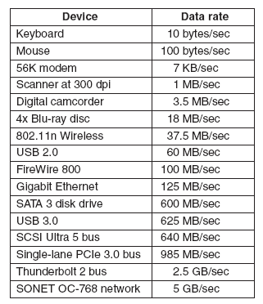
Principles of I/O Hardware
Some typical device, network, and data base rates

Slide 7
Device Controllers
I/O devices have components:
  mechanical component （device）
  electronic component
The electronic component is the device controller
  may be able to handle multiple devices
Controller's tasks
  Convert the serial bit stream into a block of bytes
  Perform any error correction necessary
  Copy it to main memory

Slide 8
Memory-Mapped I/O
Each controller has a few registers that are used for communication with CPU.
Write into these registers: OS can command the device to deliver data, accept data, switch itself on or off, or otherwise perform some action.
Read from these registers: OS can learn what the device’s state is, whether it is prepared to accept a new command, and so on.
In addition to the control registers, many devices have a data buffer that the OS can read and write (e.g. video RAM).
Q: How the CPU communicates with the control registers and the device data buffer?

Slide 9
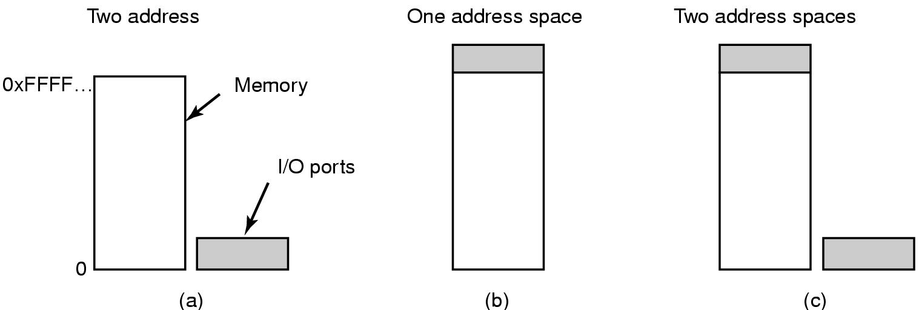
Memory-Mapped I/O (2)
(a) Separate I/O and memory space (IBM 360)
  Each control register is assigned an I/O port number.
  Address spaces for memory and I/O are different
(b) Memory-mapped I/O (PDP-11)
  Map all the control registers into the memory space.
  Each control register is assigned a unique memory address to which no memory is assigned.
(c) Hybrid (Pentium)
  Memory-mapped I/O data buffers , separate I/O ports for the control registers.

Slide 10
Memory-Mapped I/O Advantages
With memory-mapped I/O, a I/O device driver can be written entirely in C. Otherwise, some assembly code is needed.
No special protection mechanism is needed to keep user processes from performing I/O.
Every instructions that can reference memory can also reference control registers.

Slide 11
Memory-Mapped I/O Disadvantages
Most computers nowadays have some form of caching of memory words. Caching a device control register would be disastrous (blind to device ready).
Selective disable caching adds extra complexity.
If there is only one address space, then all memory modules and all I/O devices must examine all memory references to see which ones to response to.
Most modern computers have a dedicated high-speed memory bus, so I/O device have no way of seeing memory addresses as they go by on the memory bus.

Slide 12
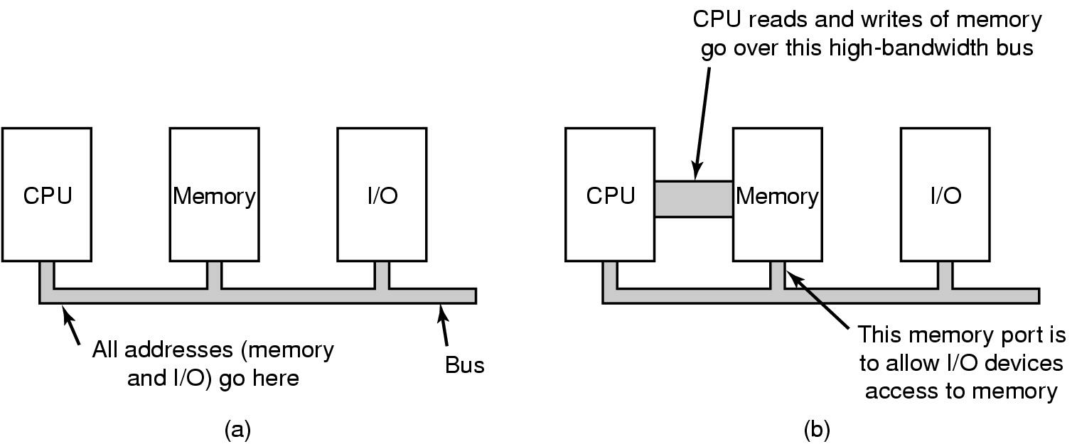
Memory-Mapped I/O Disadvantages
(a) A single-bus architecture
(b) A dual-bus memory architecture

Slide 13
Direct Memory Access (DMA)
CPU needs to address the device controllers to exchange data with them.
If request data one byte at a time, waste CPU’s time.
DMA controller has access to the system bus independent of the CPU. It contains several registers that can be written and read by the CPU.
在低端（嵌入式）计算机中，通常不使用DMA，而让比DMA控制器快得多的CPU直接做所有的工作。

Slide 14

Direct Memory Access (DMA)
Operation of a DMA transfer

Slide 15

Interrupts Revisited
Bus
How interrupts happens.
The connections between the devices and the interrupt controller actually use interrupt lines on the bus rather than dedicated wires.

Slide 16
Interrupts Revisited
When an I/O device has finished the work given to it, it causes an interrupt.
The signal is detected by the interrupt controller chip on the parentboard. If no other interrupts are pending, the interrupt controller processes the interrupt immediately.
To handle the interrupt, the controller puts a number on the address lines specifying which device wants attention and asserts a signal that interrupts the CPU.
The interrupt signal causes the CPU to stop what it is doing and start doing sth else.

Slide 17
Chapter 5: Input/Output
  5.1 Principles of I/O hardware I/O硬件原理
  5.2 Principles of I/O software I/O软件原理
  5.3 I/O software layers I/O软件层次
  5.4 Disks 盘
  5.5 Clocks 时钟
  5.6 Character-oriented terminals 面向字符的终端
  5.7 Graphical user interfaces 图形用户界面
  5.8 Network terminals 网络终端
  5.9 Power management 电源管理

Slide 18
Goals of I/O Software
Device independence
  programs can access any I/O device without specifying device in advance
    (read file from floppy, hard drive, or CD-ROM)
Uniform naming
  name of a file or device, a string or an integer
  not depending on which machine (/usr/ast/backup)
Error handling
  handle as close to the hardware as possible

Slide 19
Goals of I/O Software (2)
Synchronous vs. asynchronous transfers
  blocked transfers vs. interrupt-driven
Buffering
  data coming off a device cannot be stored in final destination (VOD)
Sharable vs. dedicated devices
  disks are sharable, CD-Rom/Printer would not be
  OS must be able to handle both shared and dedicated devices in a way that avoids problems

Slide 20
three ways to perform I/O
Programmed I/O 程序控制I/O
Interrupt-Driven I/O 中断驱动I/O
I/O Using DMA 使用DMA的I/O

Slide 21
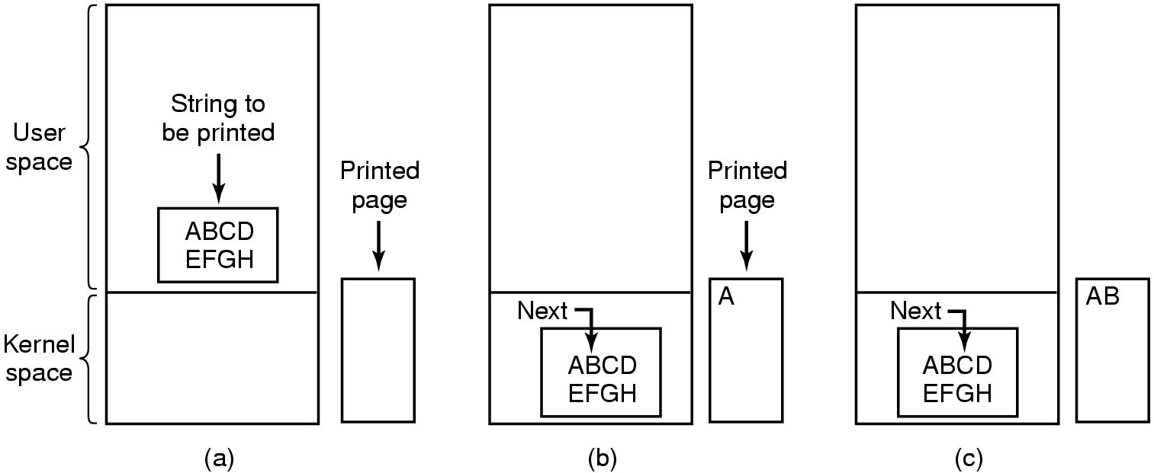
Programmed I/O
Steps in printing a string

Slide 22
Programmed I/O (2)
copy_from_user(buffer,p,count); /*p是内核缓冲区*/
for(i=0;i<count;i++){ /*对每个字符循环*/
while(*printer_status_reg!=READY); /*循环直到就绪*/
*printer_data_register=p[i]; /*输出一个字符*/
}
Return_to_user();
Writing a string to the printer using programmed I/O
Disadvantage: occupy entire CPU time untill all I/O over

Slide 23
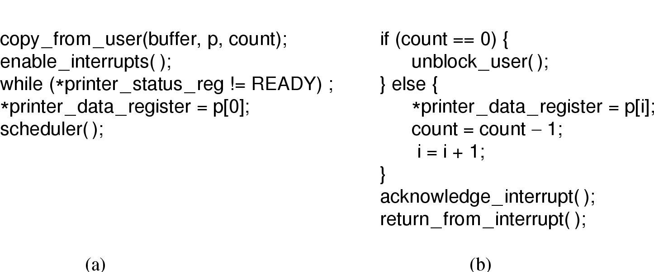
Interrupt-Driven I/O
Writing a string to the printer using interrupt-driven I/O
  (a) Code executed when print system call is made
  (b) Interrupt service procedure
Disadvantage: interrupt at every character, waste CPU time

Slide 24
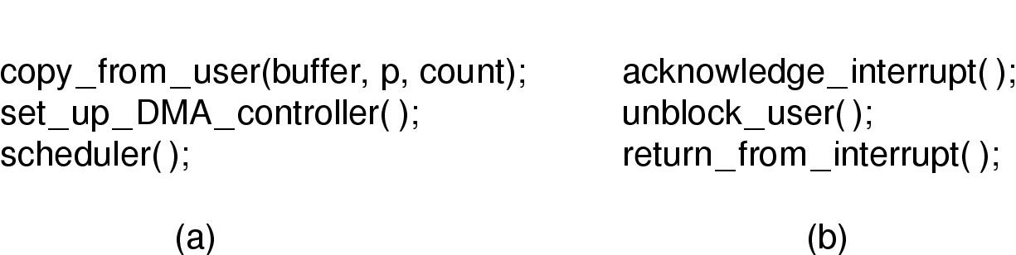
I/O Using DMA
Printing a string using DMA
  (a) code executed when the print system call is made
  (b) interrupt service procedure
将中断的次数从打印每个字符一次减少到打印每个缓冲区一次

Slide 25
Chapter 5: Input/Output
  5.1 Principles of I/O hardware I/O硬件原理
  5.2 Principles of I/O software I/O软件原理
  5.3 I/O software layers I/O软件层次
  5.4 Disks 盘
  5.5 Clocks 时钟
  5.6 Character-oriented terminals 面向字符的终端
  5.7 Graphical user interfaces 图形用户界面
  5.8 Network terminals 网络终端
  5.9 Power management 电源管理

Slide 26
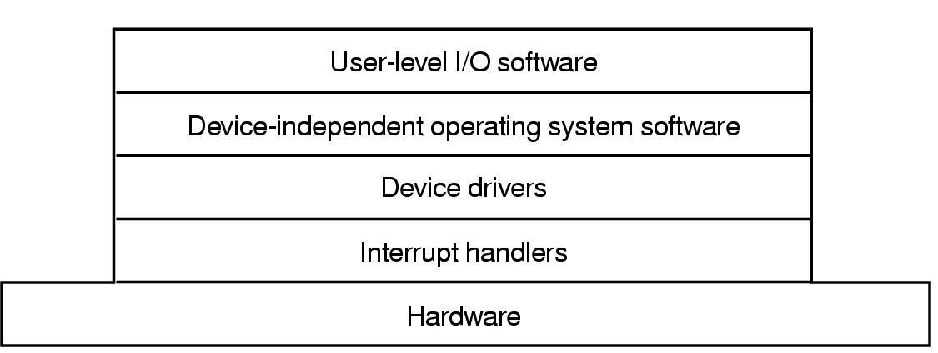
I/O Software Layers
Layers of the I/O Software System

Slide 27
Interrupt Handlers
Interrupt handlers are best hidden
  have driver starting an I/O operation block until interrupt notifies of completion
Interrupt procedure does its task
  then unblocks driver that started it
Steps must be performed in software after interrupt completed
  1). Save regs not already saved by interrupt hardware
  2). Set up context for interrupt service procedure (include setting up TLB、MMU and a page table)
  3). Set up stack for interrupt service procedure
  4). Ack interrupt controller
  5). Copy registers from where saved

Slide 28
Interrupt Handlers (2)
  6). Run the interrupt service procedure
  7). Choose which process to run next
  8). Set up MMU context for process to run next
  9). Load new process' registers
  10). Start running the new process
As can be seen , interrupt processing takes a considerable number of CPU instructions, especially on machines in which virtual memory is present and page tables have to be set up or the state of the MMU stored.

Slide 29
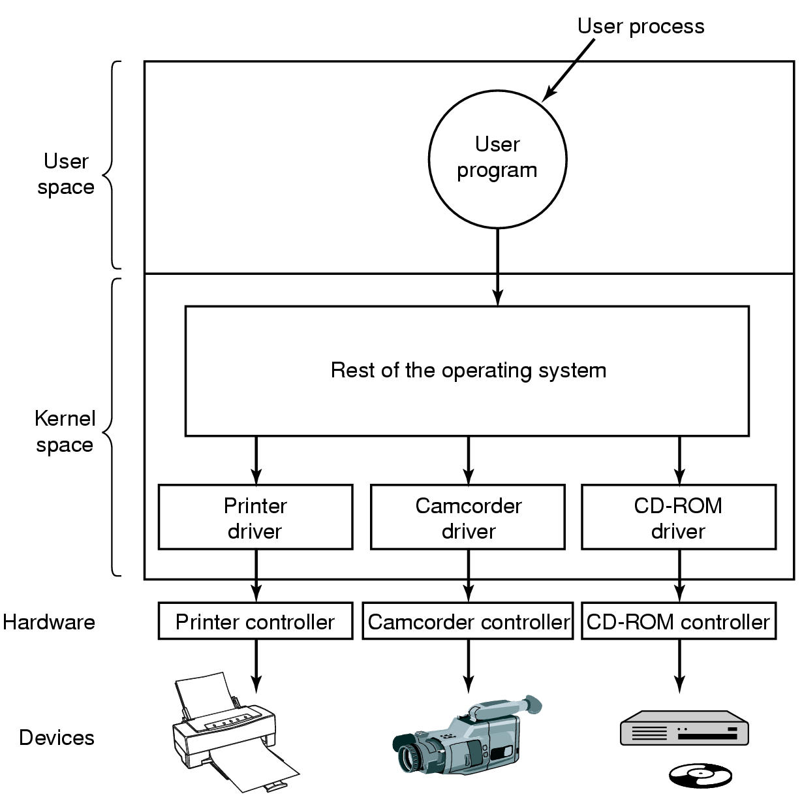
Device Drivers
Logical position of device drivers is shown here

Slide 30
Device Drivers
Communications between drivers and device controllers goes over the bus
Former UNIX system. If a new device was added, the system administrator recompiled the kernel with the new driver to build a new binary.
Starting with MS-DOS, Drives were dynamically loaded into the system during execution.

Slide 31
Device-Independent I/O Software
Uniform interfacing for device drivers
Buffering
Error reporting
Allocating and releasing dedicate devices
Providing a device-independent block size
Functions of the device-independent I/O software

Slide 32
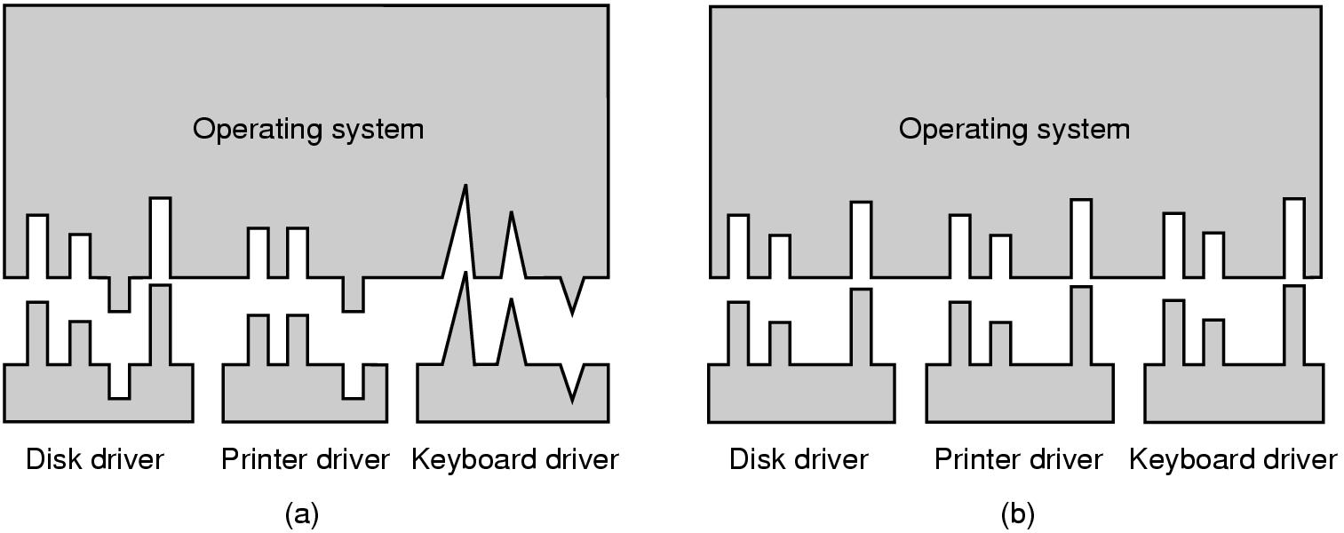
Uniform interfacing for device drivers
(a) Without a standard driver interface
every time a new device comes along, the OS must be modified for the new device.
(b) With a standard driver interface
It becomes much easier to plug in a new driver. It also means that the driver writers know what is expected to them.

Slide 33
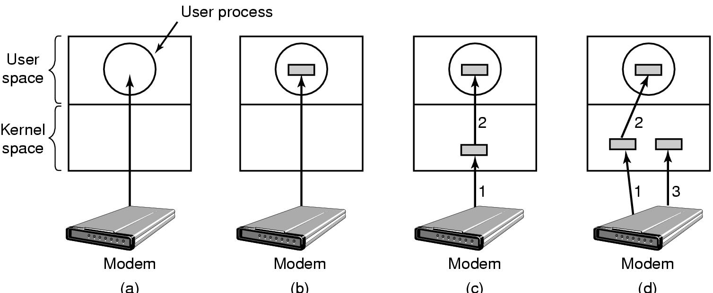
Buffering
(a) Unbuffered input
user process has to be started up for every incoming character
(b) Buffering in user space
what happens if the buffer is paged out when a character arrives?
(c) Buffering in the kernel followed by copying to user space
What happens to characters that arrive while the page with the user buffer is being brought in from the disk?
(d) Double buffering in the kernel

Slide 34
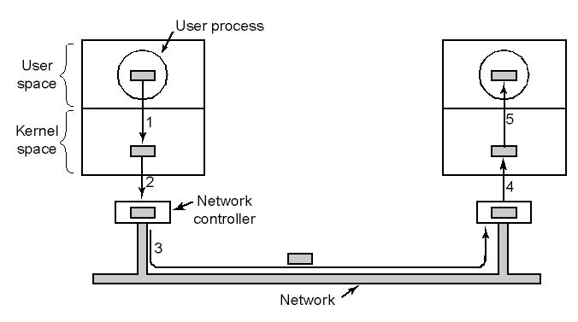
Buffering
Networking may involve many copies of a packet

Slide 35
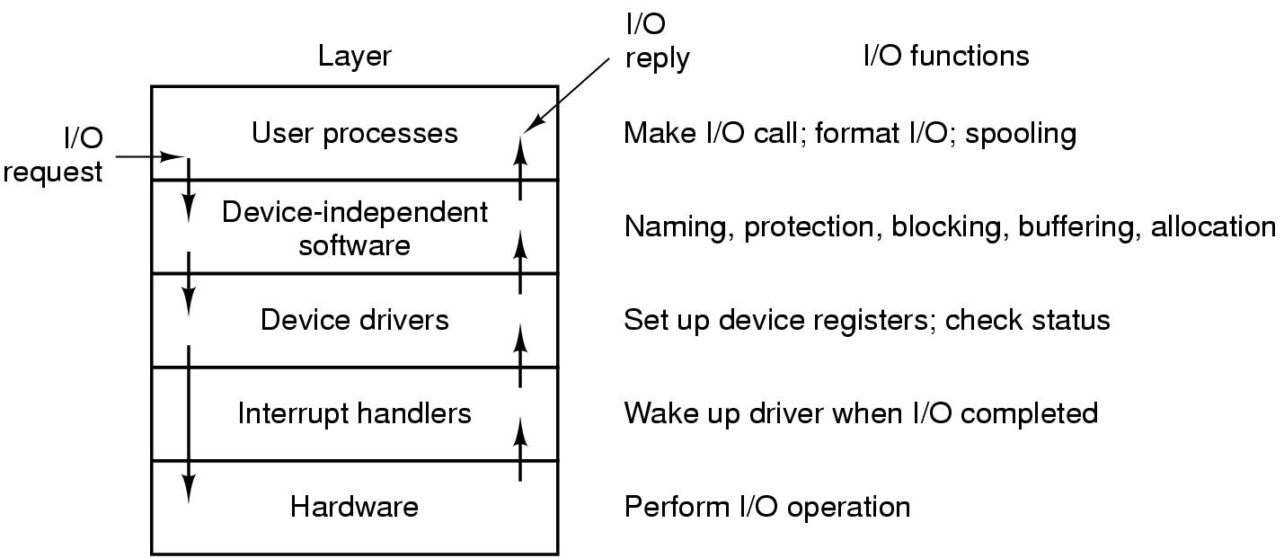
Layers of the I/O System
Layers of the I/O system and the main functions of each layer

Slide 36
Operating Systems
Lesson 2

Slide 37
Chapter 5: Input/Output
  5.1 Principles of I/O hardware I/O硬件原理
  5.2 Principles of I/O software I/O软件原理
  5.3 I/O software layers I/O软件层次
  5.4 Disks 盘
  5.5 Clocks 时钟
  5.6 Character-oriented terminals 面向字符的终端
  5.7 Graphical user interfaces 图形用户界面
  5.8 Network terminals 网络终端
  5.9 Power management 电源管理

Slide 38
Disks
Disk hardware
Disk formatting
Disk arm scheduling algorithms
Error handling
Magnetic disks: hard disks, floppy disks
Optical disks: CD-ROMs, CD-Recorderables, DVDs, Blu-ray Disc
SSD (Solid state disk)

Slide 39
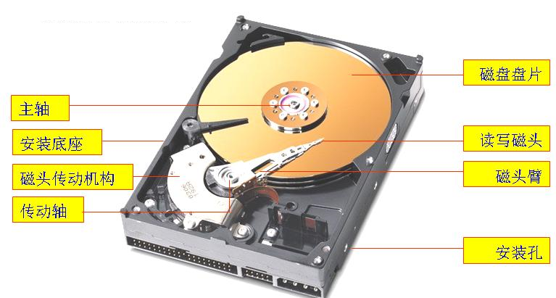
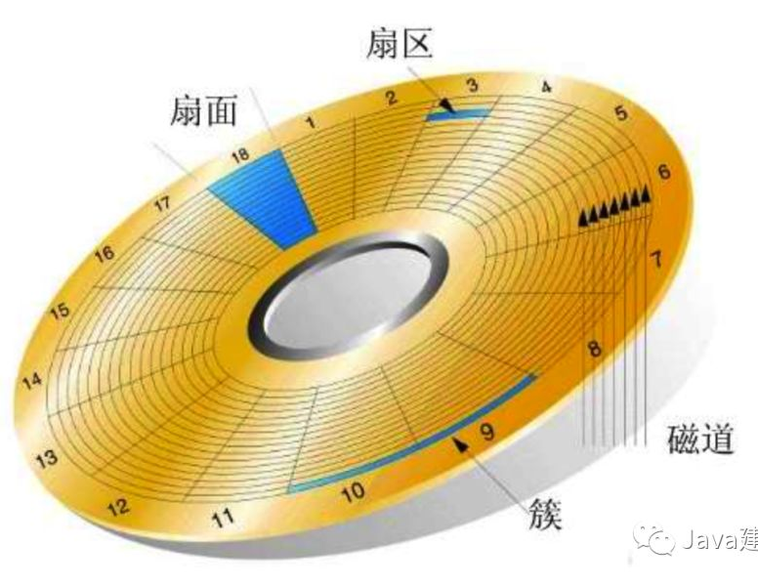
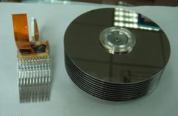
Magnetic Disks

Slide 40
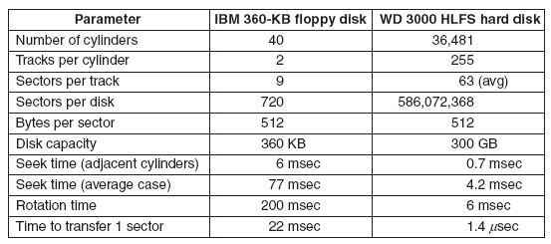
Disk Hardware
Disk parameters for the original IBM PC floppy disk and a WD 3000 hard disk
Magnetic disks are organized into cylinders, each one containing many tracks. The tracks are divided into sectors.

Slide 41
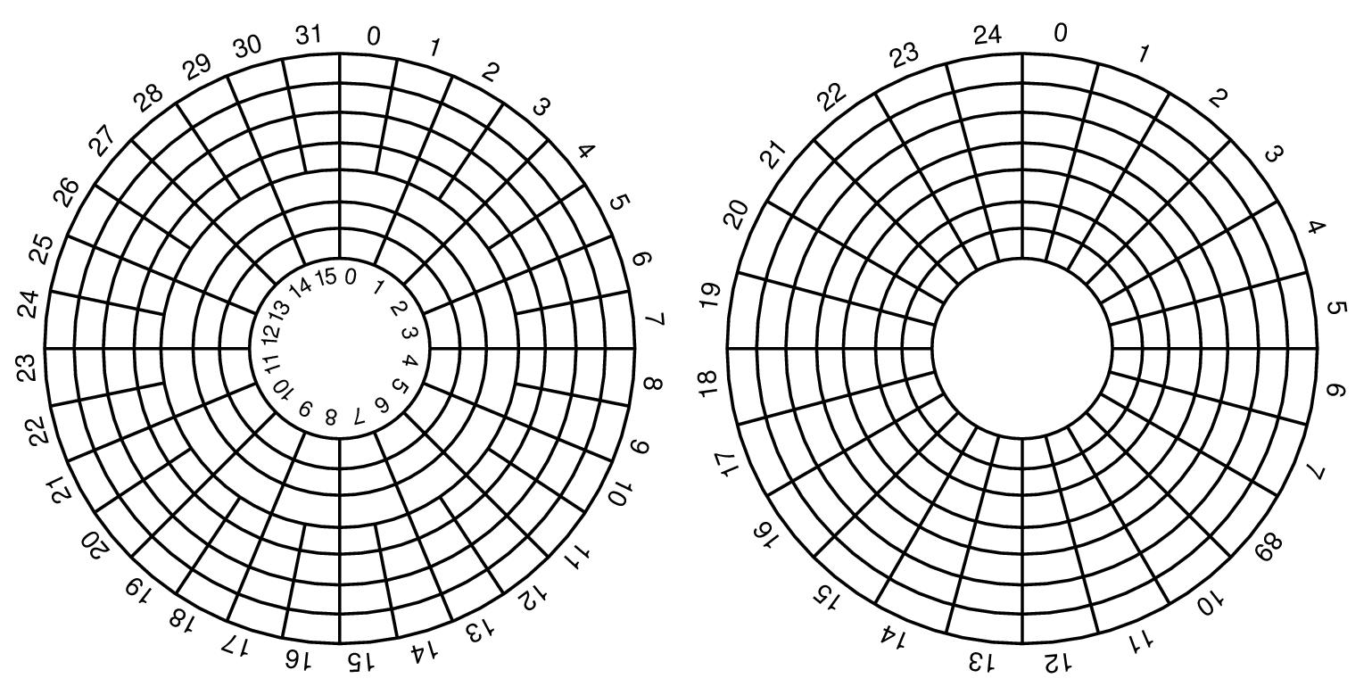
Disk Hardware (2)
Physical geometry of a disk with two zones(环带)
A possible virtual geometry for this disk

Slide 42
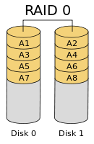
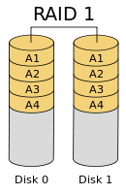
Disk Hardware :RAID0/1
Redundant Array of Independent Disk
独立磁盘冗余阵列 (level 0,1,2,3,4,5,10,01,50)
Level 0: organization writes consecutive strips over the drivers in round-robin fashion.
Level 1: duplicate all the disks, there are same backup disks as primary disks.

Slide 43
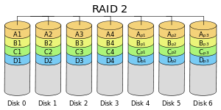
Disk Hardware :RAID2
Level 2: works on a word basis, possible even a byte basis. Hamming coded word with parity bits. (losing one drive did not cause problems)

Slide 44
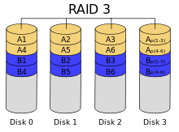
Disk Hardware :RAID3
Level 3: a simplified version of RAID level 2. a single parity bit is computed for each data word and written to a parity drive.

Slide 45
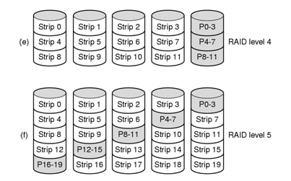
Disk Hardware :RAID4/5
Level 4 and 5 work with strips again, not individual words with parity.
Level 4 is like level 0, with a strip-for-strip parity written onto an extra drive. (heavy load on the parity drive)
Level 5: distribute the parity bits uniformly over all the drives, round robin fashion.

Slide 46
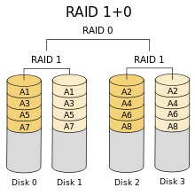
Disk Hardware :RAID10
RAID 1+0是先镜射再分区数据，再将所有硬盘分为两组，视为是RAID 0的最低组合，然后将这两组各自视为RAID 1运作。

Slide 47
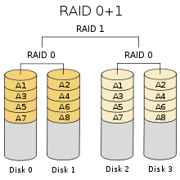
Disk Hardware :RAID01
RAID 0+1则是跟RAID 1+0的程序相反，是先分区再将数据镜射到两组硬盘。它将所有的硬盘分为两组，变成RAID 1的最低组合，而将两组硬盘各自视为RAID 0运作。
可靠性上，当RAID 1+0有一个硬盘受损，其余三个硬盘会继续运作。RAID 0+1 只要有一个硬盘受损，同组RAID 0的另一只硬盘亦会停止运作，只剩下两个硬盘运作，可靠性较低。

Slide 48
Disk Hardware :RAID50
RAID50也被称为镜象阵列条带，由至少六块硬盘组成，像RAID0一样，数据被分区成条带，在同一时间内向多块磁盘写入；像RAID5一样，也是以数据的校验位来保证数据的安全，且校验条带均匀分布在各个磁盘上。其目的在于提高RAID5的读写性能。
RAID 0/1/5/10/50实际应用中使用比较多，RAID2、3、4较少实际应用，因为RAID5已经涵盖了所需的功能。

Slide 49
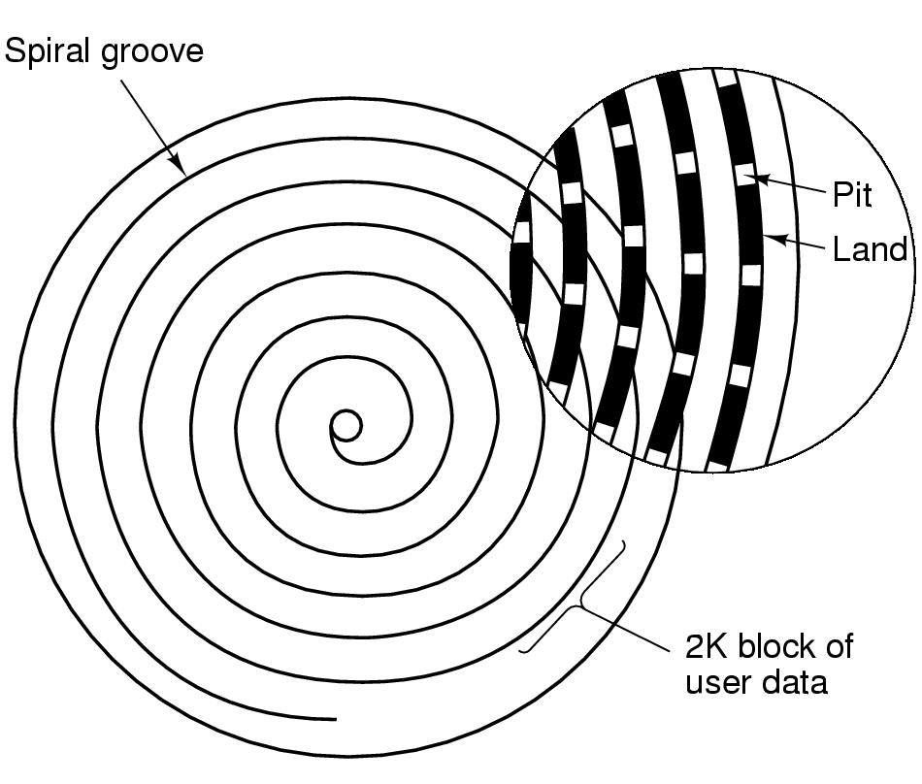
Disk Hardware: CD-ROM
聚碳酸酯
Recording structure of a CD or CD-ROM

Slide 50
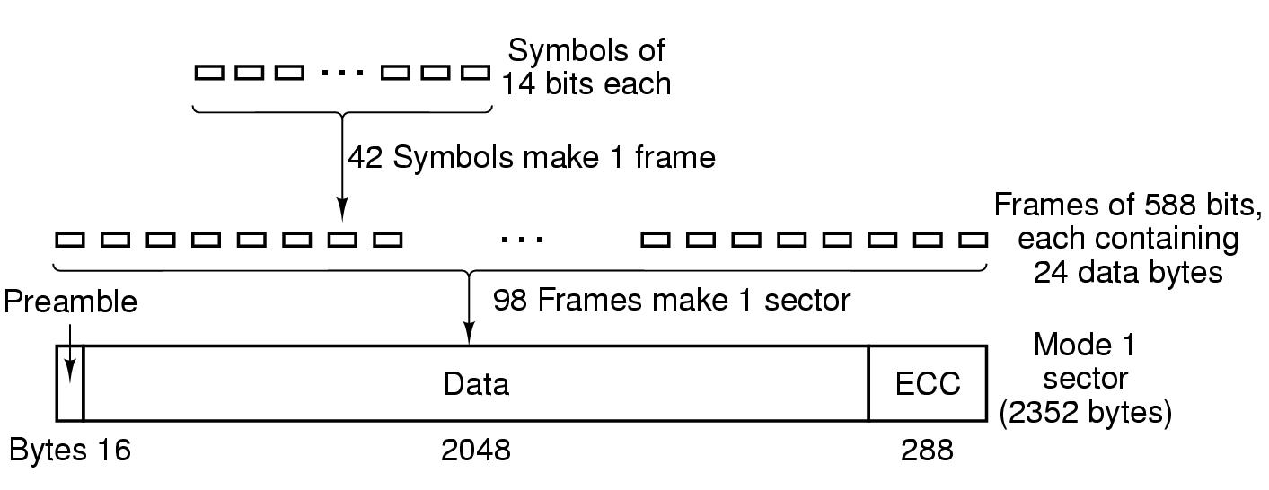
Disk Hardware: CD-ROM
Logical data layout on a CD-ROM
Basic format: encoding every byte in a 14-bit symbol.
A group of 42 consecutive symbols forms a 588-bit (42x14=588) frame 帧. Each frame holds 192 data bits (24 bytes). The remaining 396 bits are used for error correction and control.
Grouping of 98 frames into a sector 扇区. Every sector begins with a 16-byte preamble, 2048 data bytes, and a 288 byte error-correcting code. (98x24=2352)

Slide 51
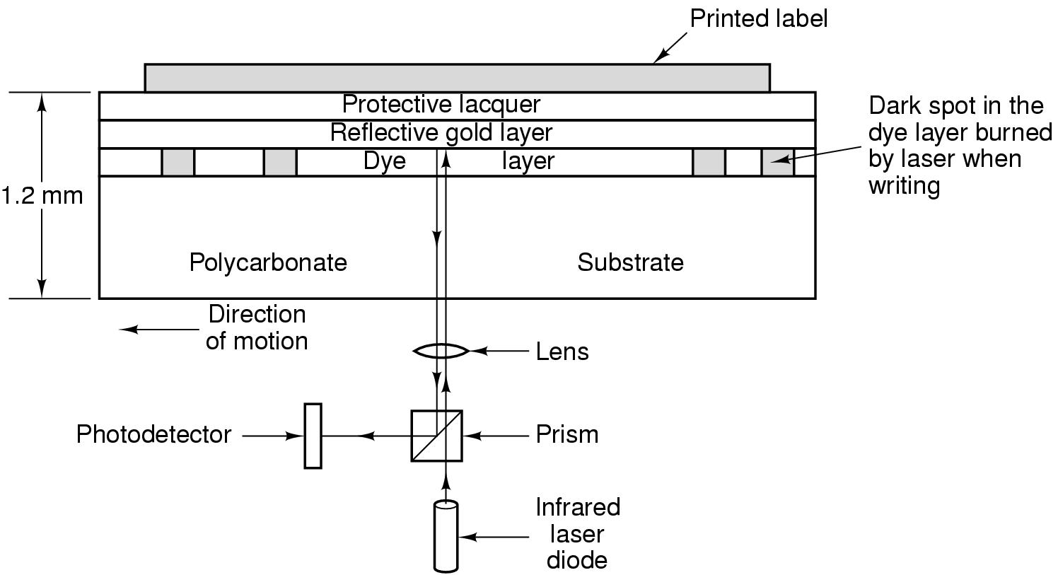
Disk Hardware: CD-R
Cross section of a CD-R disk and laser
  开始花菁染料层是透明的，在写入的时候，激光加热染料形成暗斑。读取的时候，暗斑与透明区的差别就相对于凹痕和槽脊的差别。
  CD-RW：用银、铟、锑和碲合金作为记录层，取代花菁染料。此合金有两个稳定状态：结晶态和非结晶态，具有不同反射率。

Slide 52
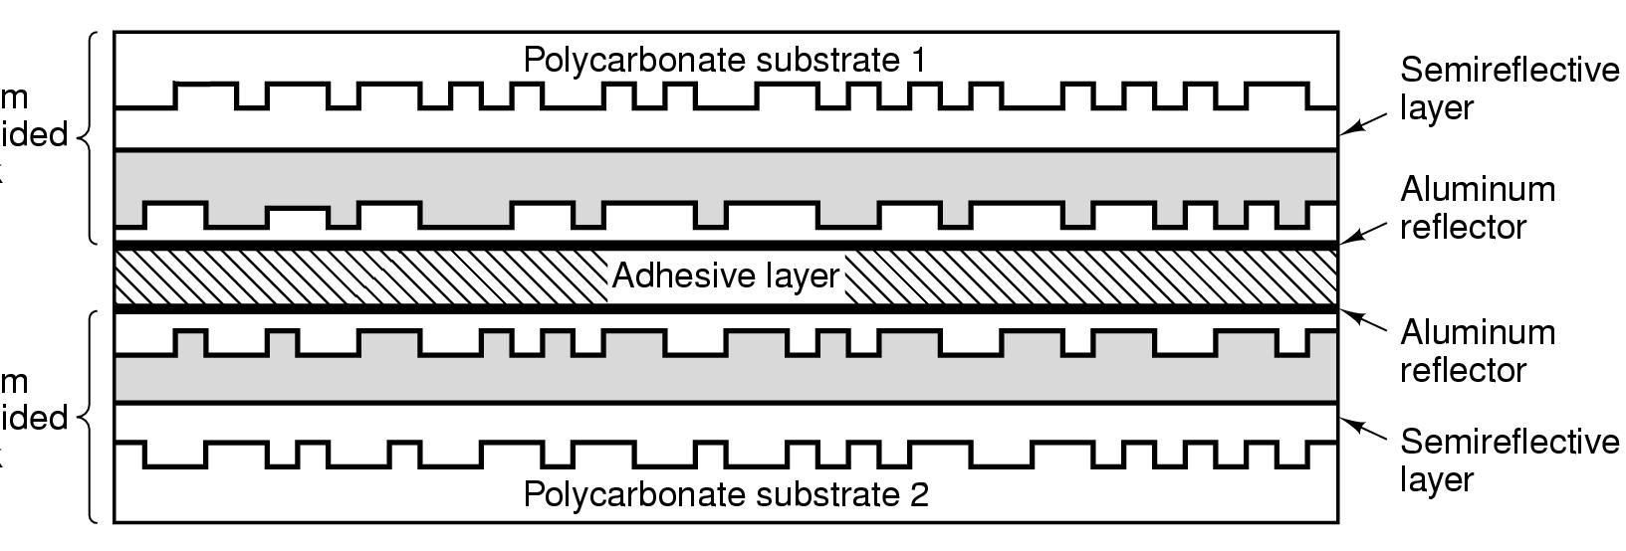
Disk Hardware: DVD
A double sided, dual layer DVD disk

Slide 53
Disk Formatting
A disk sector
Preamble: starts with a certain bit pattern that allows the hardware to recognize the start of the sector. It also contains the cylinder and sector numbers.
Data: size is determined by the low-level formatting program. Most disks use 512-byte sectors.
ECC: contains redundant information that can be used to recover from read errors.

Slide 54
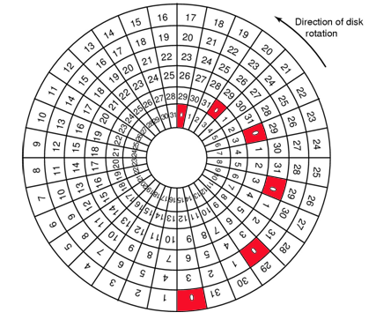
Disk Formatting (2)
Cylinder skew: the position of sector 0 on each track is offset from the previous track.

Slide 55
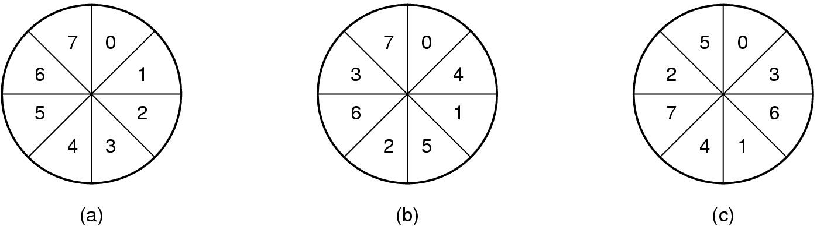
Disk Formatting (2)
(a) No interleaving 无交错 (b) Single interleaving (c) Double interleaving
A controller with a one-sector buffer that has been given a command to read two consecutive sectors.
After reading the first sector from the disk and doing the ECC calculation, the data must be transferred to main memory.
While this transfer is taking place, the next sector will fly by the head. When the copy to memory is complete, the controller will have to wait almost an entire rotation time for the second sector to come around again.
To avoid the need for interleaving, the controller should be able to buffer an entire track.

Slide 56
Disk Arm Scheduling Algorithms
Time required to read or write a disk block determined by 3 factors:
  Seek time
  Rotational delay
  Actual transfer time
Seek time dominates 主导地位
Error checking is done by controllers

Slide 57
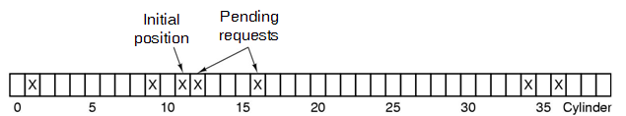
Disk Arm Scheduling Algorithms (2)
Consider an imaginary disk with 40 cylinders. A request comes in to read a block on cylinder 11. While the seek to cylinder 11 is in progress, new requests come in for cylinders 1, 36, 16, 34, 9, and 12, in that order.
FCFS algorithm
require arm motions of 10, 35, 20, 18, 25, and 3 respectively, for a total of 111 cylinders.
low efficiency.

Slide 58
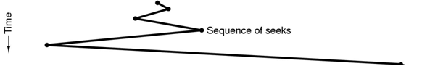
Disk Arm Scheduling Algorithms (2)
Shortest Seek First (SSF) disk scheduling algorithm
Always handle the closest request next.
The arm motions are 1, 3, 7, 15, 33, and 2, for a total of 61 cylinders.
In half compared to FCFS.
Problem：With a heavily loaded disk, the arm will tend to stay in the middle of the disk most of the time.

Slide 59
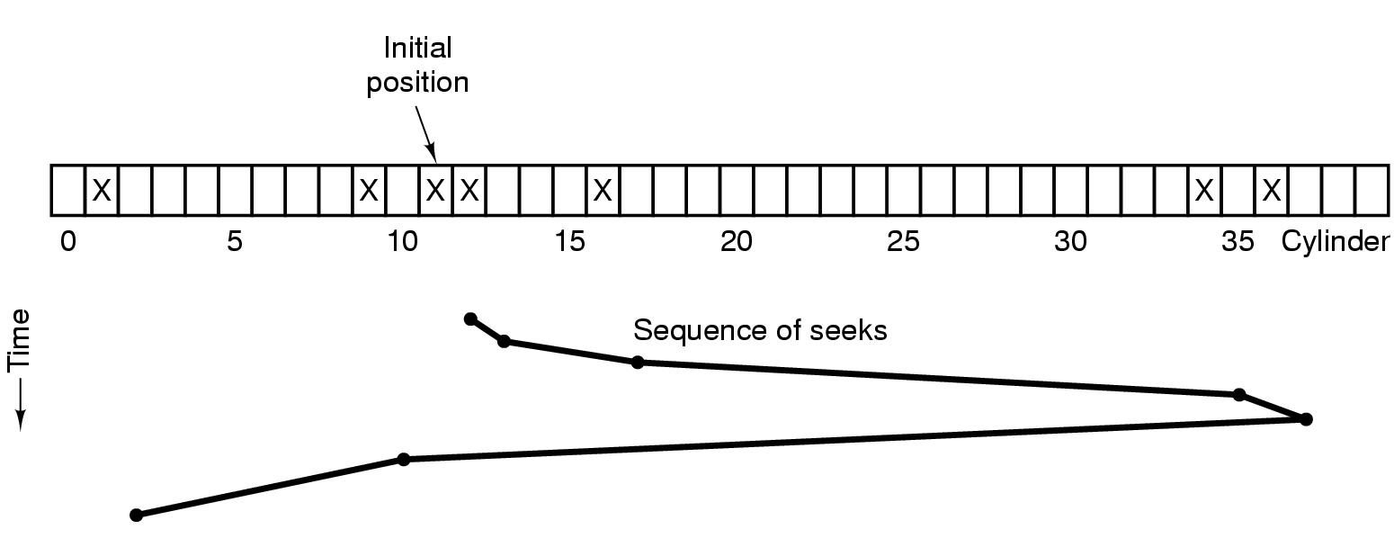
Disk Arm Scheduling Algorithms (3)
The elevator algorithm for scheduling disk requests
Keep moving in the same direction until there are no more outstanding requests in that direction.
The arm motions are 1, 4, 18, 2, 27, and 8, for a total of 60 cylinders.

Slide 60
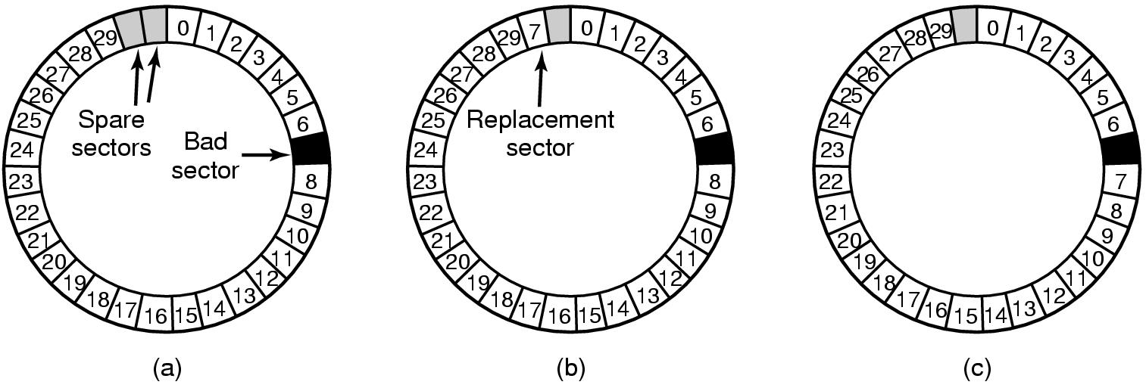
Error Handling
(a) A disk track with a bad sector
(b) Substituting a spare for the bad sector
(c) Shifting all the sectors to bypass the bad one

Slide 61
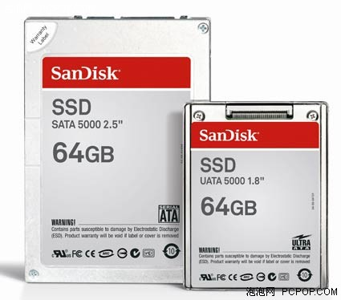
SSD
A solid-state drive (SSD) is a data storage device that uses solid-state memory to store persistent data. Unlike flash-based memory cards and USB flash drives, an SSD emulates a hard disk drive interface, thus easily replacing it in most applications. An SSD using SRAM or DRAM (instead of flash memory) is often called a RAM-drive. (from wikipedia, http://en.wikipedia.org/wiki/solid-state_drive)

Slide 62
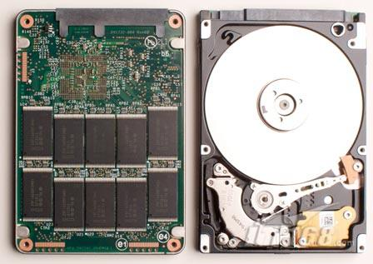
SSD
和常规硬盘相比，固态硬盘具有低功耗、无噪音、抗震动、低热量的特点。这些特点不仅使得数据能更加安全的得到保存，而且也延长了靠电池供电的设备的连续运转时间。
耗电量一般只有常规硬盘的5%，写入速度是常规硬盘的1.5倍，读取速度是常规硬盘的3倍，并且没有任何噪音。

Slide 63
Exercise
Disk requests come in to the disk driver for cylinders 86, 147, 91, 177, 94, 150, 102, 175, and 130, in that order. A seek takes 5 msec per cylinder moved. How much seek time is needed for
(a) First-come, first served.
(b) Closest cylinder next.
(c) Elevator algorithm (initially moving upward).
In all cases, the arm is initially at cylinder 143.

Slide 64
Operating Systems
Lesson 3

Slide 65
Chapter 5: Input/Output
  5.1 Principles of I/O hardware I/O硬件原理
  5.2 Principles of I/O software I/O软件原理
  5.3 I/O software layers I/O软件层次
  5.4 Disks 盘
  5.5 Clocks 时钟
  5.6 Character-oriented terminals 面向字符的终端
  5.7 Graphical user interfaces 图形用户界面
  5.8 Network terminals 网络终端
  5.9 Power management 电源管理

Slide 66
Clocks
Clocks also called timers.
Clocks maintain the time of day and prevent one process from monopolizing the CPU.
Clock hardware
Clock software

Slide 67
Clock Hardware
Traditional clock: tied to the 110- or 220- volt power line and cause an interrupt on every voltage cycle, at 50 or 60Hz.
Programmable clock: built out of three components, a crystal oscillator, a counter, and a holding register. It can get frequencies up to 1000MHz or even more. Advantage: Its interrupt frequency can be controlled by software.

Slide 68
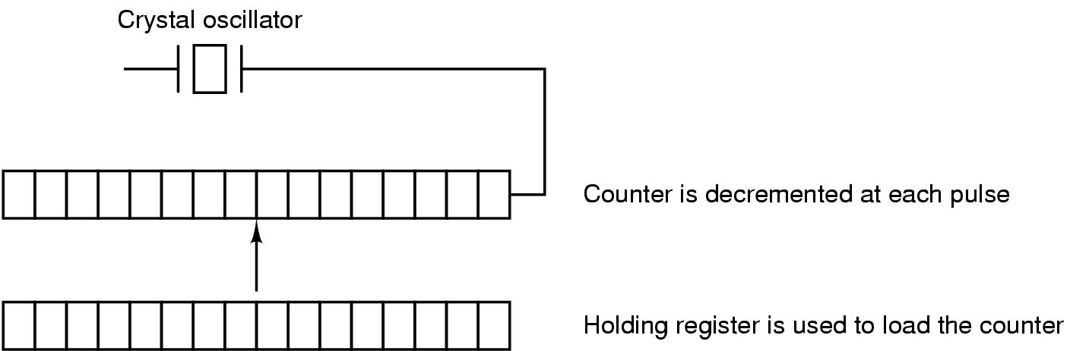
Clock Hardware (2)
A programmable clock

Slide 69
Clock Software
Duties of clock driver:
Maintaining the time of day.
Preventing processes from running longer than they are allowed to.
Accounting for CPU usage.
Handling the alarm system call made by user processes.
Providing watchdog timers for parts of the system itself.
Doing profiling, monitoring, and statistics gathering.

Slide 70
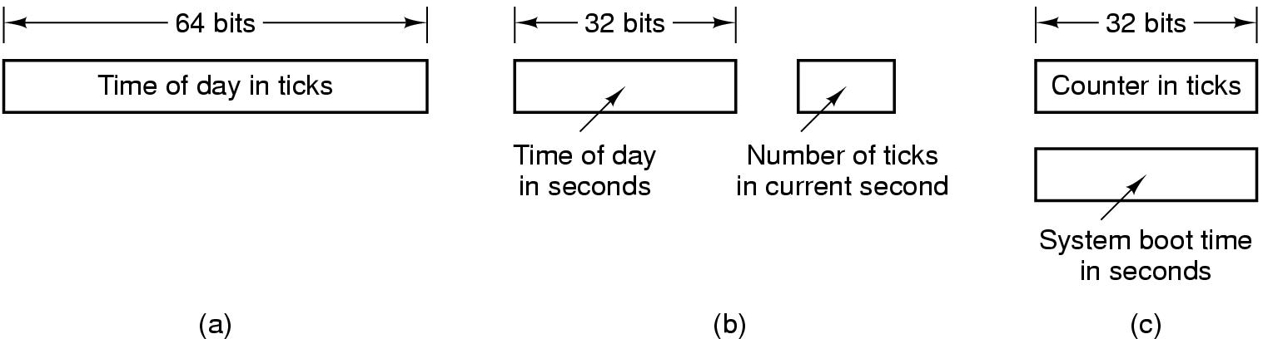
(1) Maintaining the time of day
Three ways to maintain the time of day
A 32-bit counter will overflow in just over 2 years (60Hz). Three ways to solve:
Use a 64-bit counter. makes maintaining the counter more expensive.
Maintain the time of day in seconds, using a subsidiary counter to count ticks until a whole second has been accumulated (2³²s=136y).
Count in ticks, but to do that relative to the time the system was booted, rather than relative to a fixed external moment (1970).

Slide 71
(2) Preventing pro running longer
Whenever a process is started, the schedule initializes a counter to the value of that process’ quantum in clock ticks. At every clock interrupt, the clock driver decrements the quantum counter by 1. When it gets to zero, the clock driver calls the scheduler to set up another process.

Slide 72
(3) Accounting for CPU usage
Start a second timer, distinct from the main system timer, whenever a process is started.
When that process is stopped, the timer can be read out to tell how long the process has run.

Slide 73
(4) Handling the alarm system call
A process can request that the OS give it a warning after a certain interval. The warning is usually a signal, interrupt, message, or sth similar.
e.g. A packet not acknowledged within a certain time interval must be retransmitted.

Slide 74
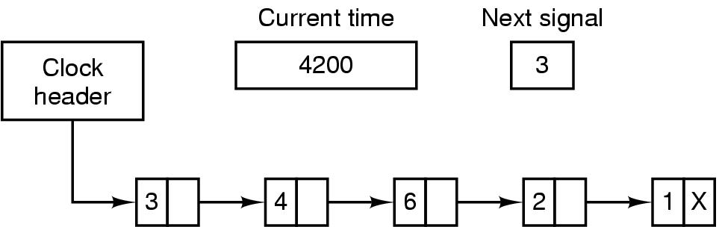
(4) Handling the alarm system call
If the clock driver had enough clocks, it could set a separate clock for each request. Otherwise, it must simulate multiple virtual clocks with a single physical clock.
It is efficient to simulate multiple clocks by chaining all the pending clock requests together, sorted on time, in a linked list.
Simulating multiple timers with a single clock
Signals are pending for 4203, 4207, 4213, 4215, and 4216.

Slide 75
(5) Providing watchdog timers
Parts of the OS also need to set timers. These are called watchdog timers 监视定时器.
e.g. Floppy disks do not rotate when not in use. When data are needed from a floppy disk, the motor must first be started.

Slide 76
Soft Timers
A second clock available for timer interrupts
  specified by applications
  no problems if interrupt frequency is low
  Generally, two ways to manage I/O:
  Interrupt, have low latency, but have a substantial overhead due to the need for context switching and their influence on the pipeline, TLB and cache.
  Polling 轮询, avoids interrupt, but there may be substantial latency.

Slide 77
Soft Timers
  If the timer frequency is very high, neither the overhead of interrupts nor the latency of polling is acceptable.
  (e.g. Gigabit Ethernet, accepting or delivering a full-size packet every 12μs)
Soft timers avoid interrupts
  kernel checks for soft timer expiration before it exits to user mode
  how well this works depends on rate of kernel entries

Slide 78
Chapter 5: Input/Output
  5.1 Principles of I/O hardware I/O硬件原理
  5.2 Principles of I/O software I/O软件原理
  5.3 I/O software layers I/O软件层次
  5.4 Disks 盘
  5.5 Clocks 时钟
  5.6 Character-oriented terminals 面向字符的终端
  5.7 Graphical user interfaces 图形用户界面
  5.8 Network terminals 网络终端
  5.9 Power management 电源管理

Slide 79
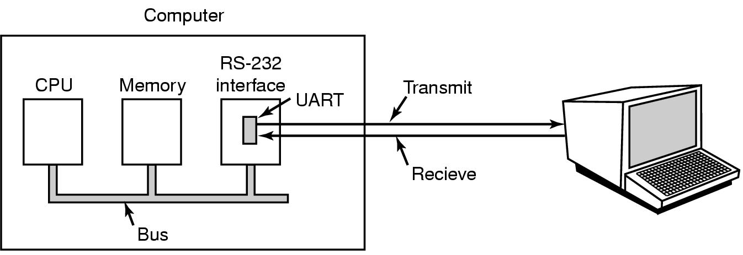
RS-232 Terminal Hardware
An RS-232 terminal communicates with computer 1 bit at a time
Called a serial line – bits go out in series, 1 bit at a time
Windows uses COM1 and COM2 ports,
On Unix, serial lines have names like /dev/tty1 and /dev/tty2

Slide 80
RS-232 Terminal Hardware
Computer and terminal are completely independent
UART (Universal Asynchronous Receiver Transmitter通用异步收发器 ) do the character-to-serial and serial-to-character conversions
Application: bank, supermarket

Slide 81
Chapter 5: Input/Output
  5.1 Principles of I/O hardware I/O硬件原理
  5.2 Principles of I/O software I/O软件原理
  5.3 I/O software layers I/O软件层次
  5.4 Disks 盘
  5.5 Clocks 时钟
  5.6 Character-oriented terminals 面向字符的终端
  5.7 Graphical user interfaces 图形用户界面
  5.8 Network terminals 网络终端
  5.9 Power management 电源管理

Slide 82
Graphical user interfaces
GUI has four essential elements, denoted by the characters WIMP:
Window
Icon
Menu
Pointing device
The GUI software can be implemented in either user-level code, as is done in UNIX system, or in operating system itself, as in the case in Windows.

Slide 83
Display Hardware
Display device:
vector graphics 矢量图形: devices can accept and carry out commands such as drawing points, lines, geometric figures, and text.
raster graphics 栅格图形: devices represent the output area as a rectangular grid of points called pixels.

Slide 84
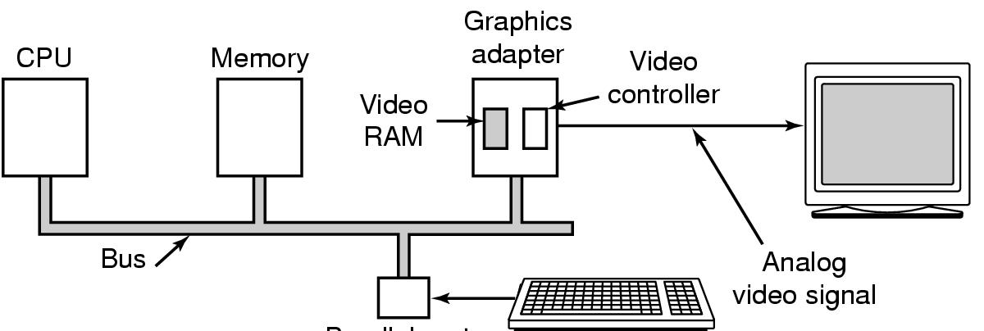
Display Hardware (2)
Parallel port
Memory-mapped displays
driver writes directly into display's video RAM

Slide 85
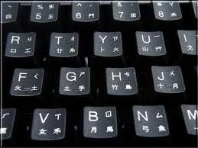
Input Software
Keyboard driver delivers a number
  driver converts to characters
  uses a ASCII table
Exceptions, adaptations needed for other languages
  many OS provide for loadable keymaps (键盘映射) or code pages(代码表)

Slide 86
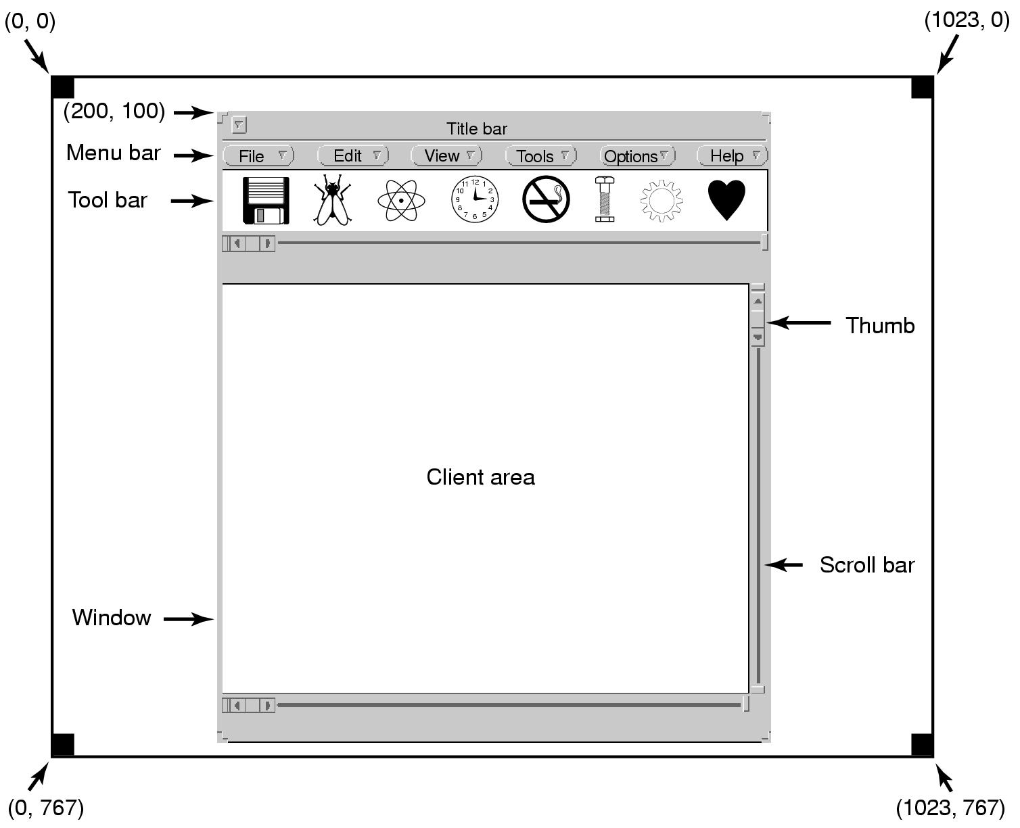
Output Software for Windows (1)
Sample window located at (200,100) on XGA display

Slide 87
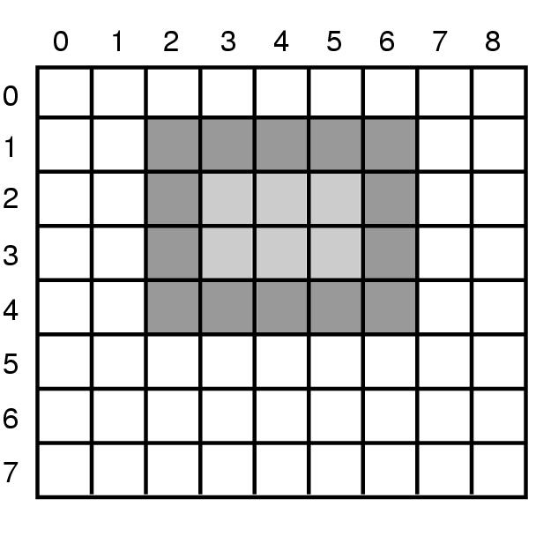
Output Software for Windows (2)
An example rectangle drawn using Rectangle
Rectangle(hdc,2,1,6,4);

Slide 88
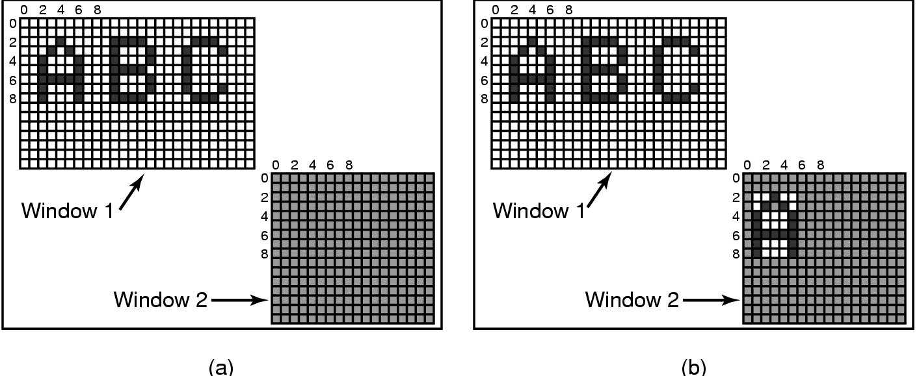
Output Software for Windows (3)
Copying bitmaps using BitBlt.
  (a) before (b) after
  BitBlt(hdc2,1,2,5,7,hdc1,2,2,SRCCOPY);

Slide 89
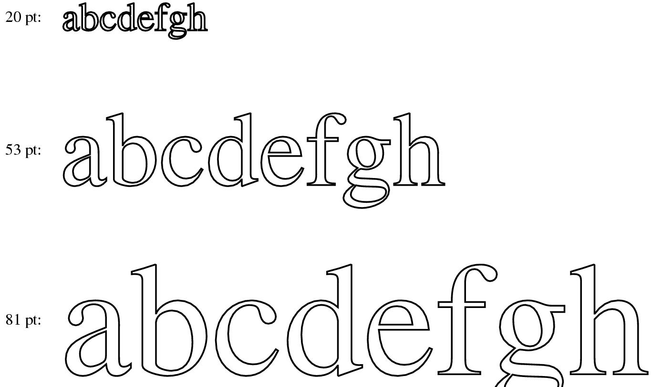
Output Software for Windows (4)
Examples of character outlines at different point sizes
TrueType字体，不是位图而是字符的轮廓，通过围绕在其周界的一系列点来定义

Slide 90
Chapter 5: Input/Output
  5.1 Principles of I/O hardware I/O硬件原理
  5.2 Principles of I/O software I/O软件原理
  5.3 I/O software layers I/O软件层次
  5.4 Disks 盘
  5.5 Clocks 时钟
  5.6 Character-oriented terminals 面向字符的终端
  5.7 Graphical user interfaces 图形用户界面
  5.8 Network terminals 网络终端
  5.9 Power management 电源管理

Slide 91
Network Terminals
Network terminals are used to connect a remote user to computer over a network.
Two types of terminals:
The terminal have a large amount of computing power and memory in order to run complex protocols to compress the amount of data sent over the network. (X Windows)
The terminal is very simple, basically displaying pixels and not doing much thinking in order to make it cheap. (SLIM)

Slide 92
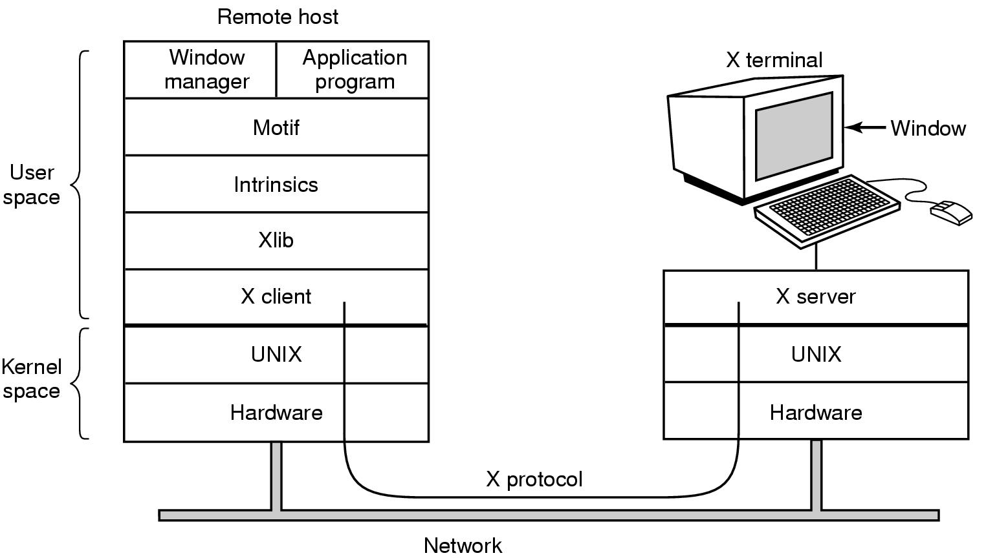
X Windows
Clients and servers in the M.I.T. X Window System

Slide 93
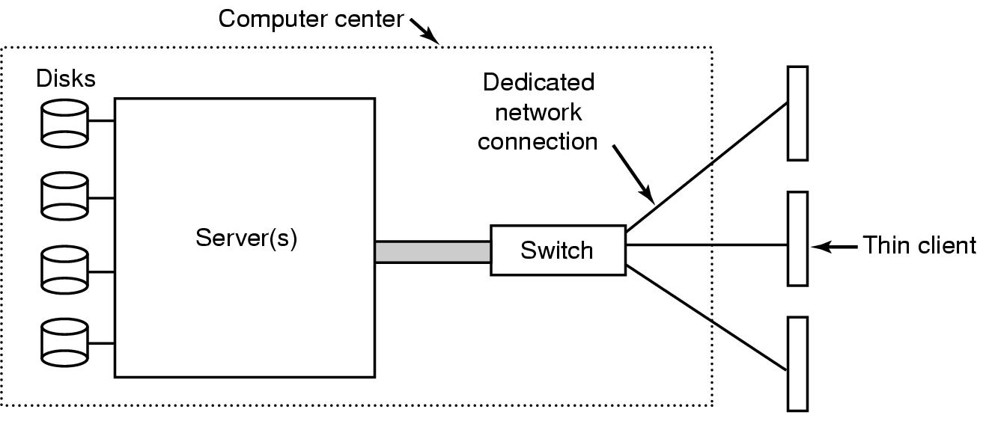
The SLIM Network Terminal (1)
The architecture of the SLIM terminal system
Stateless Low-level Interface Machine无状态低级接口机

Slide 94
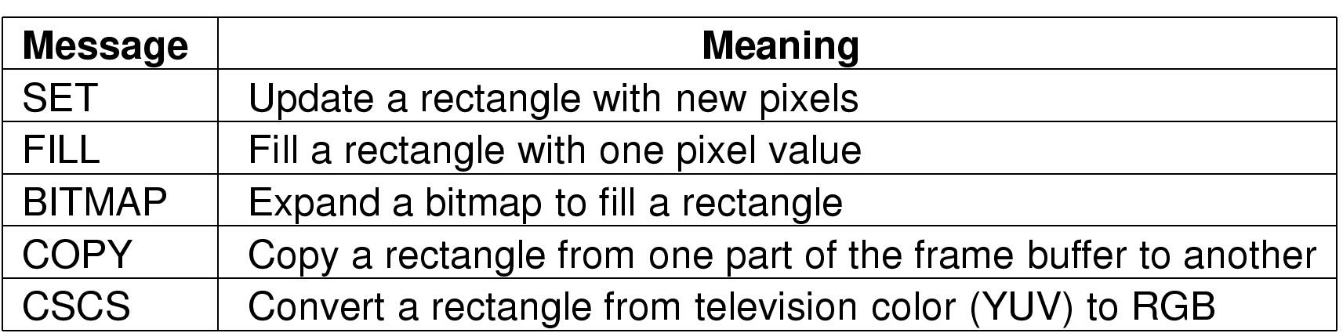
The SLIM Network Terminal (2)
Messages used in the SLIM protocol from the server to the terminals

Slide 95
Chapter 5: Input/Output
  5.1 Principles of I/O hardware I/O硬件原理
  5.2 Principles of I/O software I/O软件原理
  5.3 I/O software layers I/O软件层次
  5.4 Disks 盘
  5.5 Clocks 时钟
  5.6 Character-oriented terminals 面向字符的终端
  5.7 Graphical user interfaces 图形用户界面
  5.8 Network terminals 网络终端
  5.9 Power management 电源管理

Slide 96
Power Management
A desktop PC often has a 200-watt power supply.
Notebook, battery-powered computers.
General solutions:
Turn off parts of the computer when they are not in use.
Ask application program to use less energy, possibly degrading the quality of the user experience.

Slide 97
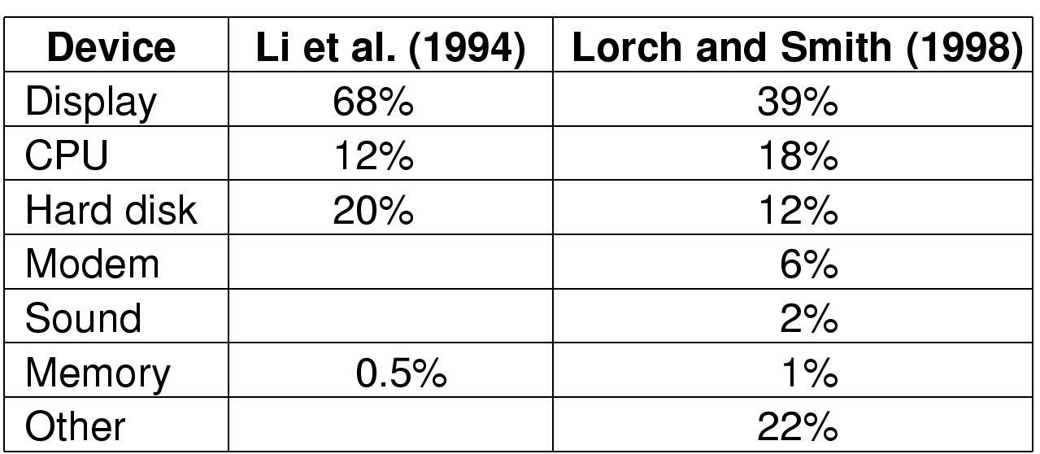
Power Management (1)
Power consumption of various parts of a laptop computer

Slide 98

Power management : Display
The use of zones for backlighting the display

Slide 99

Power Management :CPU
(a) Running at full clock speed
(b) Cutting voltage by two
  cuts clock speed by two, cuts power by four

Slide 100
Degraded operation
Telling the programs to use less energy
  may mean poorer user experience
Examples
  change from color output to black and white
  less resolution or detail in an image

Slide 101
Homework
P430, No.24

